Slide 1
Covid 19 Timeline Analysis The Sparks Foundation Task 8

Slide 2
Project analysis slide 3
Project Analysis
Covid 19 ANALYSIS
Specification
Tableau Sheets
Tableau Dashboard
Final ANALYSIS
Timely analysis with Tableau Dashboard consisting of World Confirmed Cases. Also Top Ten States of India consisting of confirmed cases and deaths.
The datasets can be downloaded from websites ourworldindata.org and prsindia.org. Datasets include vaccine and beds availability too.
Sheets includes confirmed cases and deaths of world and India. Also States of India with maps, bar charts, dual line charts etc.
A time-lapse created with all charts that has been synched with dates from the year 2020-2021 in the dashboard.
People Vaccinated and beds availability has been added in this year shown in sheets with analysis.

Slide 3
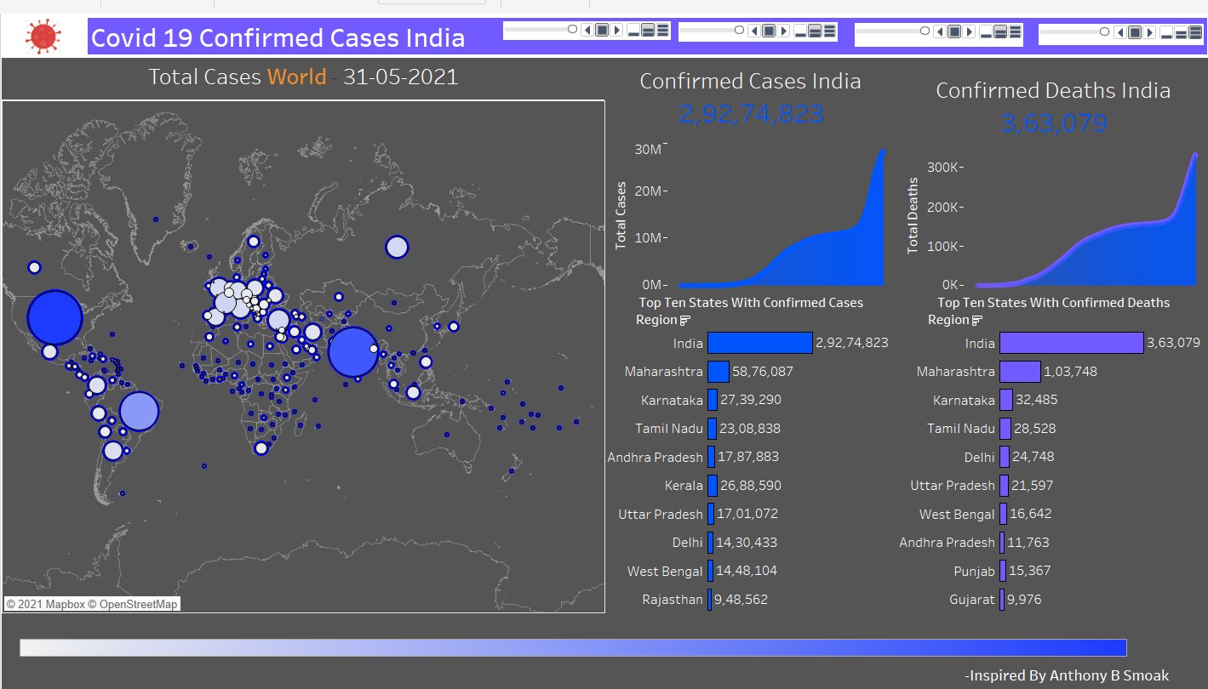
Project analysis slide 5
Dashboard 1 Analysis
Confirmed World India
Confirmed Deaths India
Top ten States confirmed cases and deaths
30M
300K
Top ten States confirmed cases and deaths according to website PRS India as of June is shown above.
According to ourworldindata confirmed cases as of June 2021 is around 30M.
And deaths according to ourworldindata as of June 2021 is around 300K

Slide 4
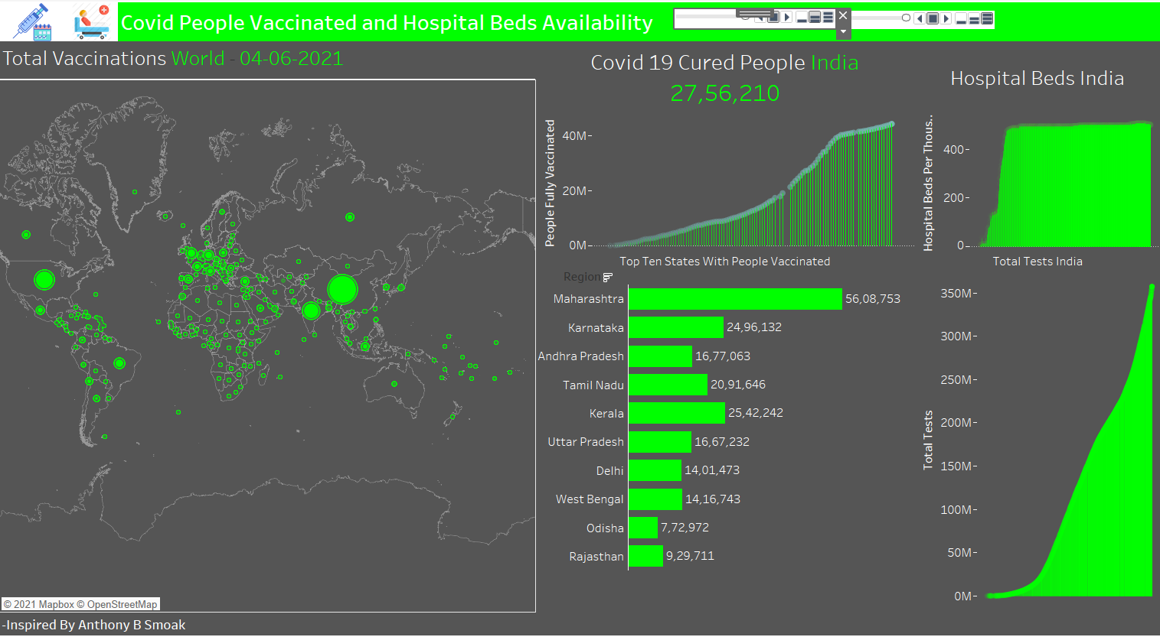
Project analysis slide 10
Dashboard 2 Analysis
According to ourworldindata around 40M people have been fully vaccinated and cured people are around 27L according to PRS India as of June 2021.
Top Ten States bar chart an dual line axis chart timely analysis shows People Vaccinated and Total tests done until June 2021
Hospital Beds according to ourworldindata are around 500K in India as of June 2021.

Slide 5
Thank You

